Slide 1

Airplane Crash Analysis
By: AMALJITH C K

Slide 2
CONTENT
About the project
Dataset Description
Import the Data
Clean the Data
Visualize the Data
Conclusion

Slide 3
About the Project
This internship project focuses on conducting a comprehensive analysis of airplane crashes and fatalities spanning from 1980 to 2023. The dataset contains crucial information such as crash dates, locations, operators, flight details, aircraft types, and fatality statistics. The goal is to leverage Power BI for interactive visualizations and in-depth insights to understand patterns, contributing factors, and trends in aviation incidents. The analysis aims to provide stakeholders with valuable information for enhancing aviation safety and mitigating risks.

Slide 4
Dataset Description:
1. Date: Date of the airplane crash. 11. Aboard Passengers: Number of passengers aboard the aircraft.
2. Time: Time of the airplane crash. 12. Aboard Crew: Number of crew members aboard the aircraft.
3. Location: Location where the airplane crash occurred. 13. Fatalities: Total fatalities in the incident.
4. Operator: Operator or airline involved in the incident. 14. Fatalities Passengers: Number of passenger fatalities.
5. Flight #: Flight number associated with the incident. 15. Fatalities Crew: Number of crew member fatalities.
6. Route: Planned route of the flight. 16. Ground: Casualties on the ground, if any.
7. AC Type: Aircraft type involved in the crash. 17. Summary: Brief summary or description of the incident.
8. Registration: Registration details of the aircraft.
9. cn/ln: Construction or serial number of the aircraft.
10. Aboard: Total number of individuals aboard the aircraft.

Slide 5
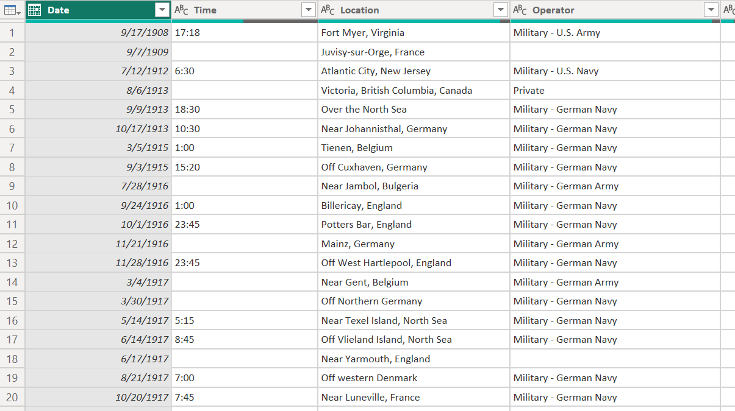
Dataset

Slide 6
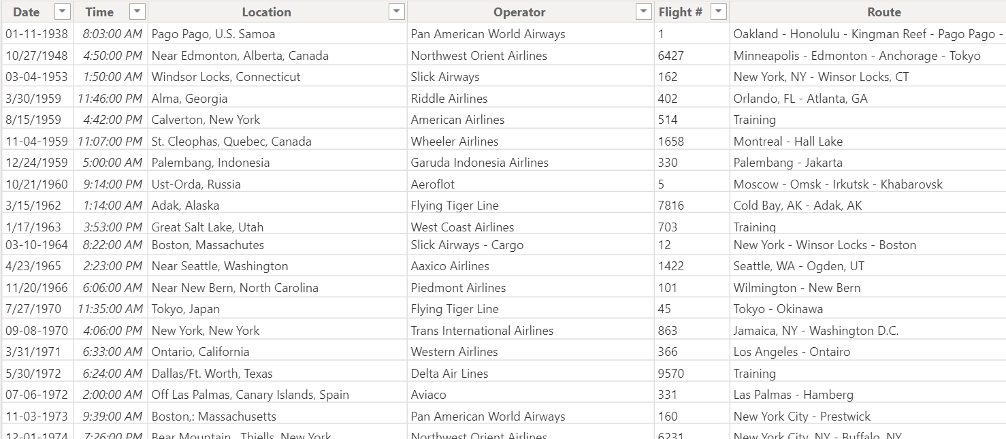
After cleaning the dataset.

Slide 7
Project Objectives:
1. Temporal Analysis
2. Geospatial Analysis
3. Operator Performance
4. Aircraft Analysis
5. Fatality Trends
6. Route Analysis

Slide 8

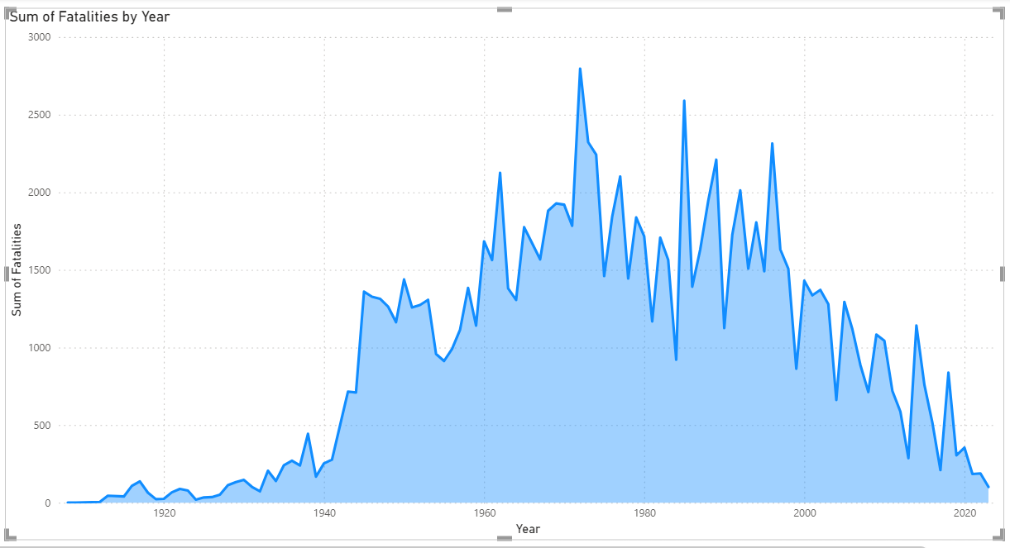
Temporal Analysis
Line chart was used to show the number of airplane crashes per year
Highest number of fatalities are occured in the year 1972

Slide 9
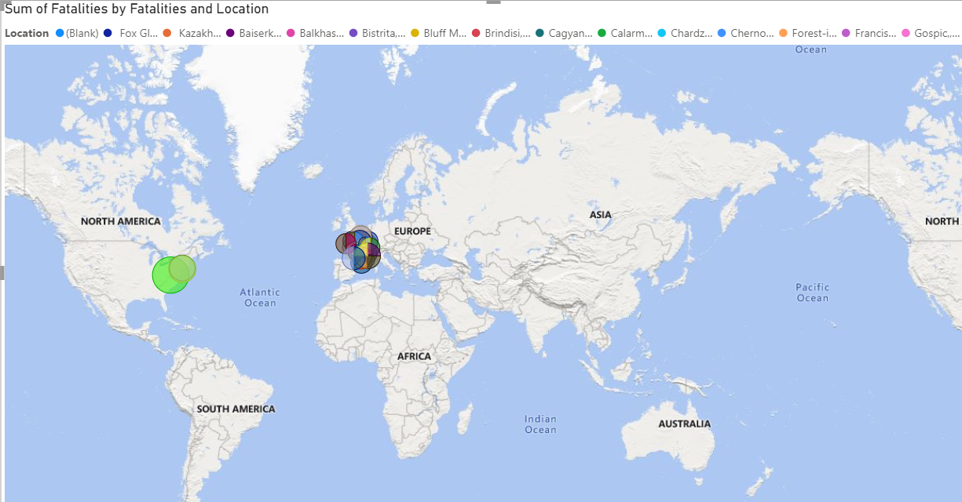
2. Geospatial Analysis
Filled Map was used to show the location of hotspots where the number of occurrence of fatalities are high.
Highest number of fatalities are occured in Tenerife, Canary Islands

Slide 10
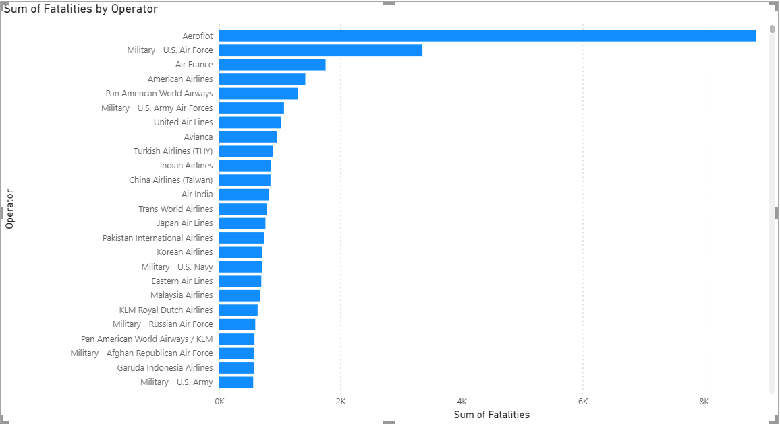
3. Operator Performance
Bar Chart was used to show the frequency of Operator and corresponding Fatalities.
Highest number of fatalities are occured Aeroflot Operator.

Slide 11
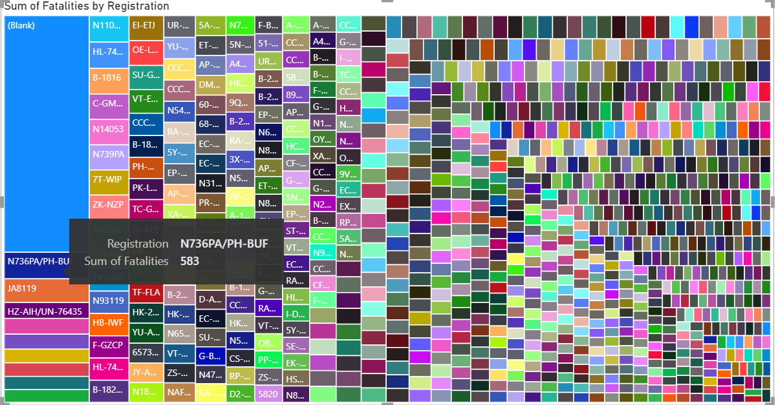
4. Aircraft Analysis(1)
Treemap is used to show the relationship between aircraft registration and number of fatalities.
N736PA/PH-BUF registration cause the highest number of fatalities.

Slide 12
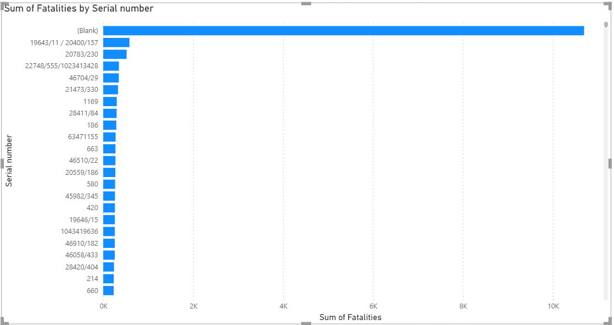
4. Aircraft Analysis(2)
To show the frequency of incidents for each aircraft type by number of fatalities.
Airplane with serial number 19643/11 / 20400/157 has the highest aircraft fatality rate.

Slide 13
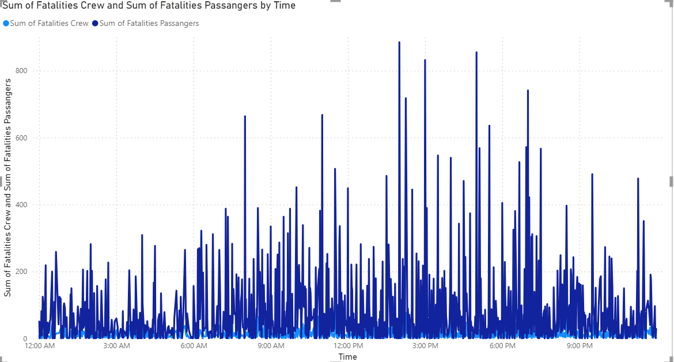
5. Fatality Trends(1)
To show the number of fatalities in passanger and crew over time.
From this visualization we can find that time 2 PM : 7 PM was the highest airplane fatalities rate in the world.

Slide 14
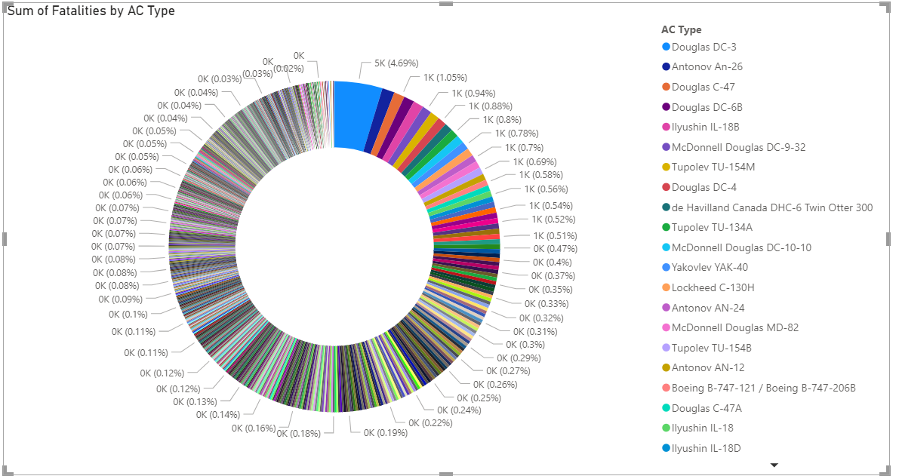
5. Fatality Trends(2)
To show the correlation between different AC Type and the number of fatalities .
From this visualization we can find that there is a relationship between AC Type : Douglas DC-3 and the total number of fatalities, as it represents the cause of 4.69%.

Slide 15
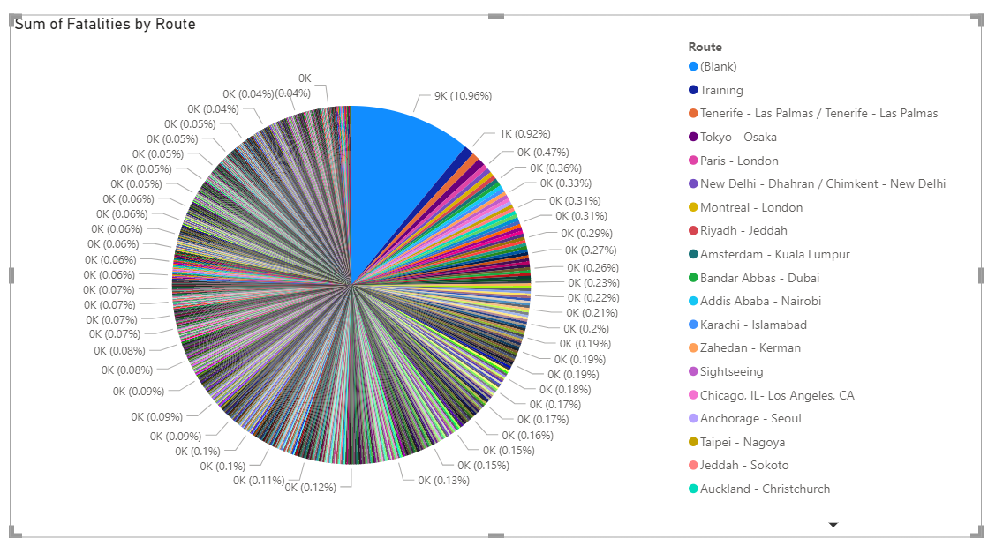
6. Route Analysis
To find the route that have higher likelihood of incidents.
From this visualization we can find that Route: Training was the highest airplane fatalities rate in the world with 0.92%.

Slide 16
Analysis Conclusions
The year 1972 was the highest rate of fatalities in the world.
There is a relationship between operator Aeroflot airlines with serial number 19643/11 / 20400/157 and the number of fatalities.
There is a relationship between Registration details of the aircraft (N736PA/PH-BUF), AC Type : Douglas DC-3 and the number of fatalities.
Highest number of fatalities are occured in Tenerife, Canary Islands
Route: Training was the highest airplane fatalities rate in the world with 0.92%.

Slide 17
What I Learn
How to clean a dirty data set for getting the accurate output.
What is the the purpose of different type of visualizations.
Source File: Power BI

Slide 18
THANK YOU

